Slide 1

Android Training
Notes:
Module 01:Activities

Slide 2

Data Storage Options

Slide 3
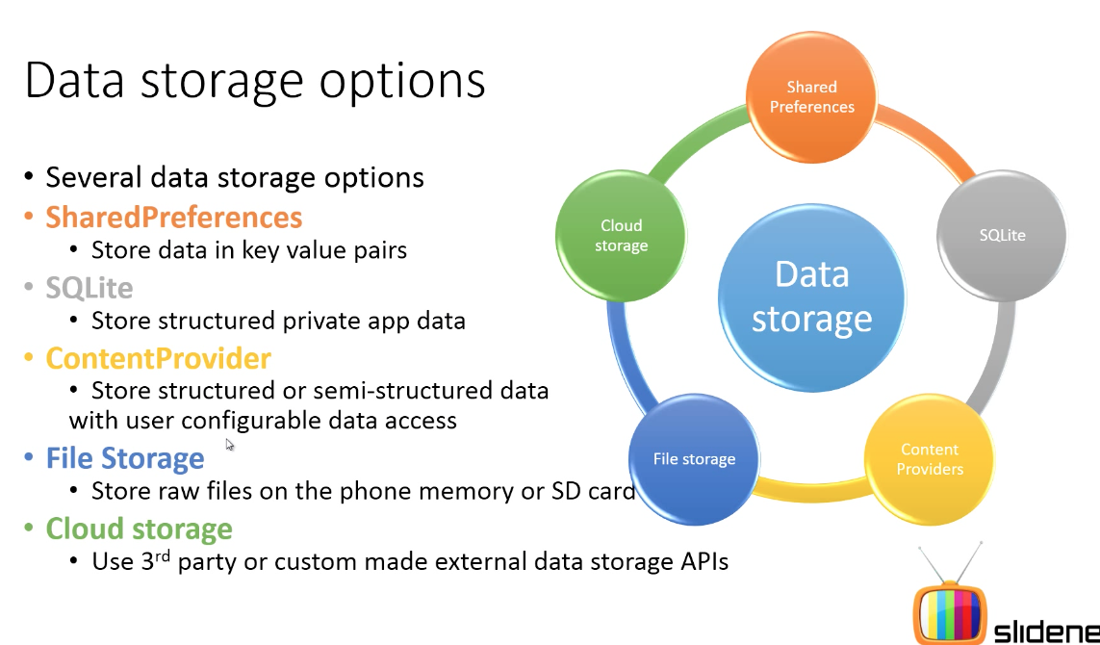
Five Ways to Deal With Data
May & June 2012 Recruiting Plan
q
© 2014 Unbounded Solutions
3

Slide 4


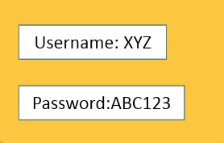
1#Shared Preferences
May & June 2012 Recruiting Plan
Shopping Sites
q
Shared Preferences
KEY
VALUE
KEY
VALUE
© 2014 Unbounded Solutions
4

Slide 5
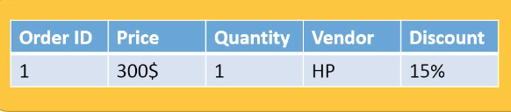
2#SQLite
May & June 2012 Recruiting Plan
Shopping Sites
q
SQLite
© 2014 Unbounded Solutions
5

Slide 6

3#ContentProvider
May & June 2012 Recruiting Plan
Shopping Sites
q
Content
Provider
© 2014 Unbounded Solutions
6

Slide 7
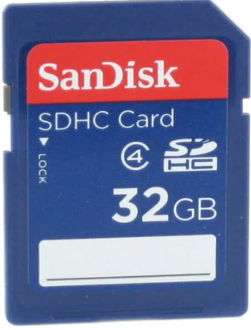
4#File Storage
May & June 2012 Recruiting Plan
Shopping Sites
q
© 2014 Unbounded Solutions
7

Slide 8
5#Cloud Storage
May & June 2012 Recruiting Plan
Shopping Sites
q
Cloud Storage
© 2014 Unbounded Solutions
8

Slide 9
Sqlite Database Schema

Slide 10
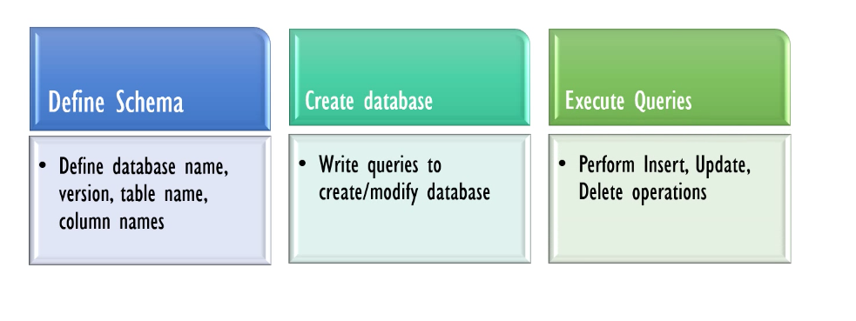
The Steps To Create Database
May & June 2012 Recruiting Plan
q
© 2014 Unbounded Solutions
10

Slide 11
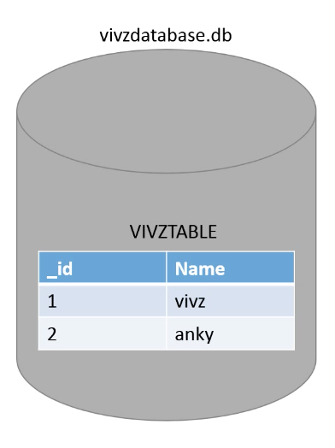
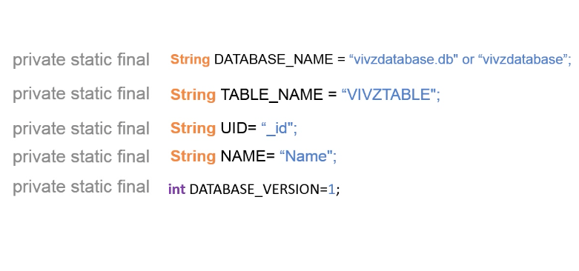
Step1#Define the Schema
May & June 2012 Recruiting Plan
q
© 2014 Unbounded Solutions
11

Slide 12
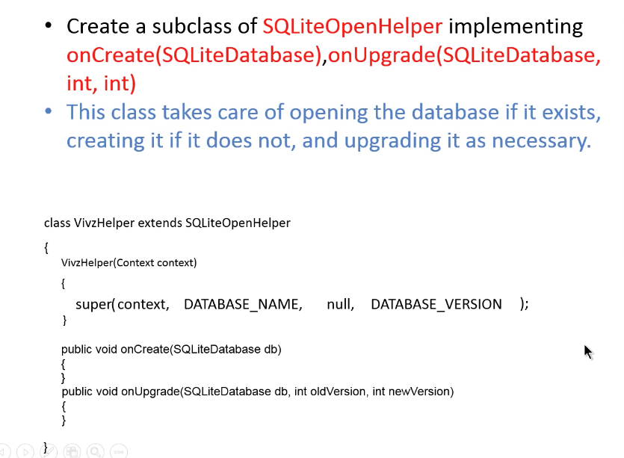
The SQLiteOpenHelper
May & June 2012 Recruiting Plan
q
© 2014 Unbounded Solutions
12

Slide 13
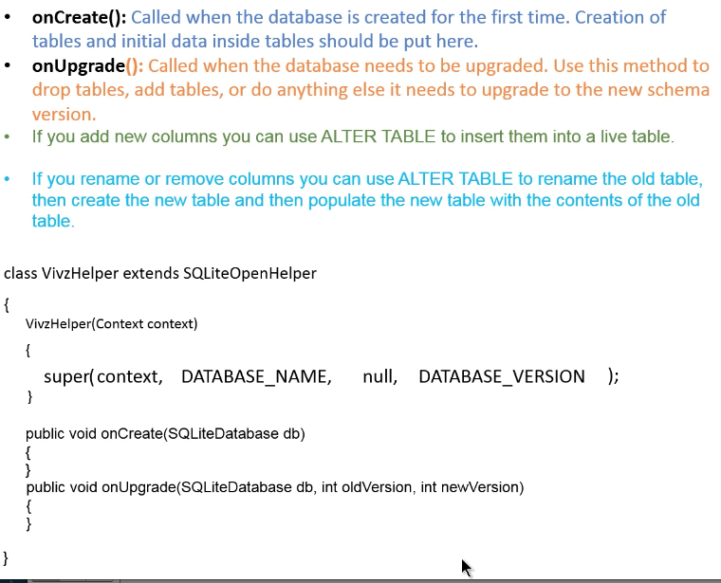
Callback Methods
May & June 2012 Recruiting Plan
q
© 2014 Unbounded Solutions
13

Slide 14
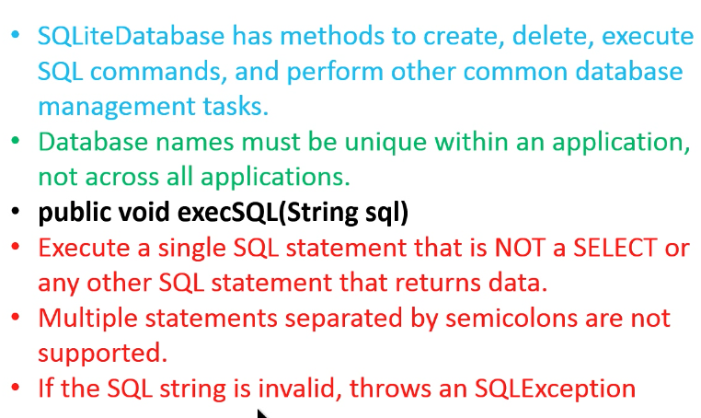
The SQLiteDatabase Class
May & June 2012 Recruiting Plan
q
© 2014 Unbounded Solutions
14

Slide 15
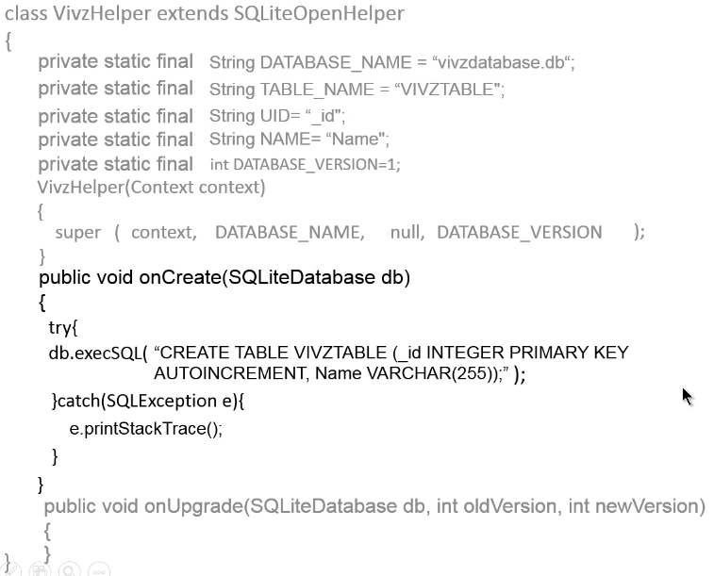
1#Implement the OnCreate()
May & June 2012 Recruiting Plan
q
© 2014 Unbounded Solutions
15

Slide 16
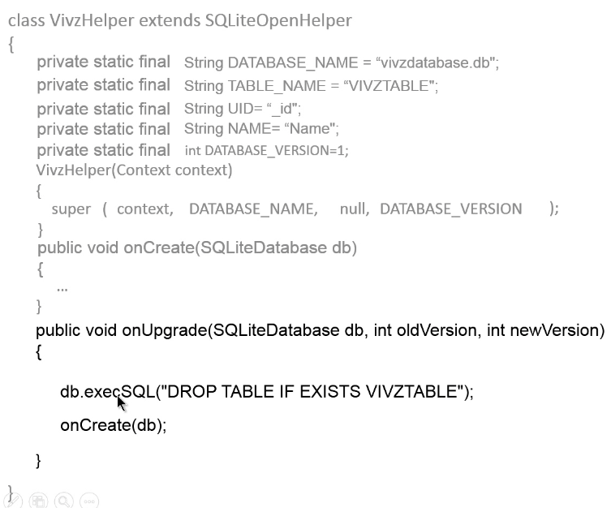
2#Implement the OnUpgrade()
May & June 2012 Recruiting Plan
q
© 2014 Unbounded Solutions
16

Slide 17

Topic #1
May & June 2012 Recruiting Plan
Recruit 70 “Best Fit” Consulting Employees
Build out a Marketing team dedicated to recruiting
Formalize training program for new recruiters
Build out fully functioning offshore recruiting team
Implement call quality feedback loops
Coach and Mentor recruiters
Improve daily efficiency for recruiting team
Creating SQLite Database
© 2014 Unbounded Solutions
17

Slide 18
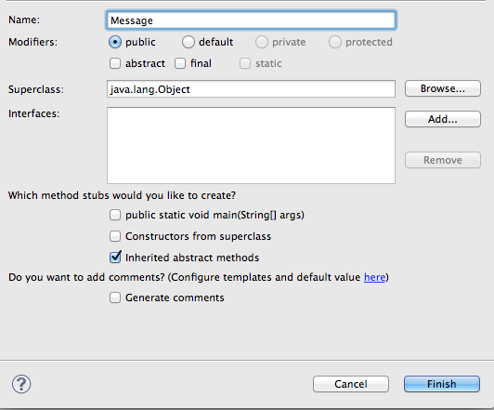
1#Create a New Class
May & June 2012 Recruiting Plan
q
© 2014 Unbounded Solutions
18

Slide 19
1#Create a New Class
May & June 2012 Recruiting Plan
q
public class Message {
public static void message(Context context,String message){
Toast.makeText(context, message, Toast.LENGTH_LONG);
}
}
© 2014 Unbounded Solutions
19

Slide 20
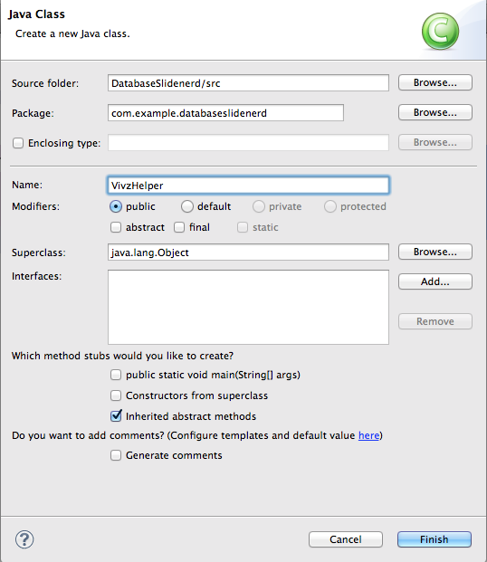
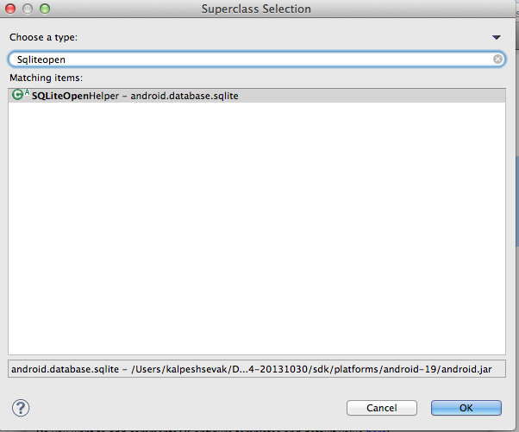
2#Create Database Class
May & June 2012 Recruiting Plan
q
© 2014 Unbounded Solutions
20

Slide 21
Class Extends SqliteOpenHelper
May & June 2012 Recruiting Plan
q
public class VivzHelper extends SQLiteOpenHelper {
@Override
public void onCreate(SQLiteDatabase arg0) {
// TODO Auto-generated method stub
}
@Override
public void onUpgrade(SQLiteDatabase arg0, int arg1, int arg2) {
// TODO Auto-generated method stub
}
© 2014 Unbounded Solutions
21

Slide 22
3#Create a Constructor
May & June 2012 Recruiting Plan
q
public VivzHelper(Context context) {
//SQLiteOpenHelper Constructor
//@param 1: Context object
//@param 2: DATABASE NAME STRING OBJECT
//@param 3: CURSOR OBJECT TO READ TABLE ONE ROW AT A TIME
//@param 4: DATABASE_VERSION int OBJECT
super(context,"",null,1);
}
© 2014 Unbounded Solutions
22

Slide 23
4#Define the Schema
May & June 2012 Recruiting Plan
q
public class VivzHelper extends SQLiteOpenHelper {
public static final String DATABASE_NAME="Vivz.db";
public static final String TABLENAME="VIVZTABLE";
public static final int DATABASE_VERSION=1;
//Column Names
public static final String UID="_id";
public static final String NAME="Name";
//UPDATE THE CONSTRUCTOR
public VivzHelper(Context context) {
super(context,DATABASE_NAME,null,DATABASE_VERSION);
}
© 2014 Unbounded Solutions
23

Slide 24
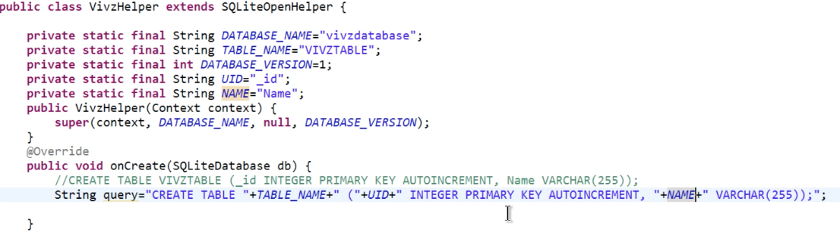
4#Define the Schema
May & June 2012 Recruiting Plan
q
© 2014 Unbounded Solutions
24

Slide 25
Working with Insert

Slide 26
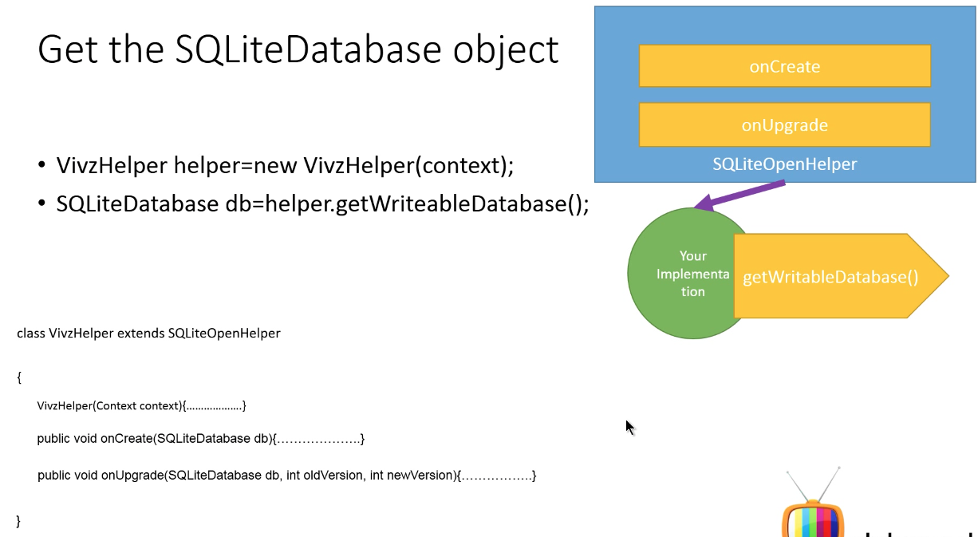
Steps Followed So Far..
May & June 2012 Recruiting Plan
q
© 2014 Unbounded Solutions
26

Slide 27
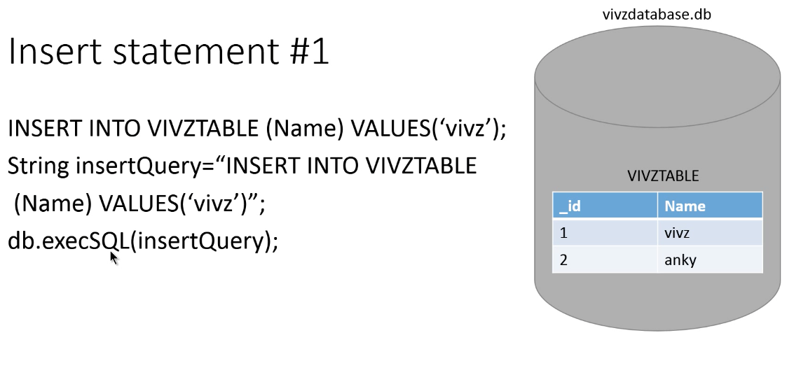
Java Way
May & June 2012 Recruiting Plan
q
© 2014 Unbounded Solutions
27

Slide 28
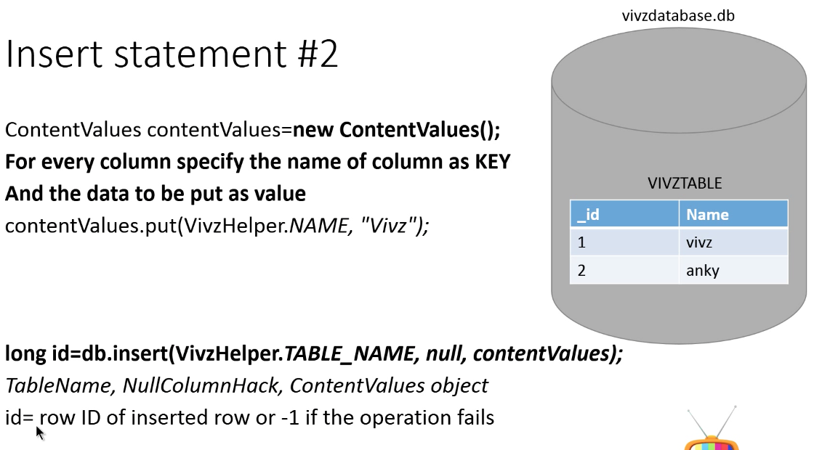
Android Way
May & June 2012 Recruiting Plan
q
© 2014 Unbounded Solutions
28

Slide 29
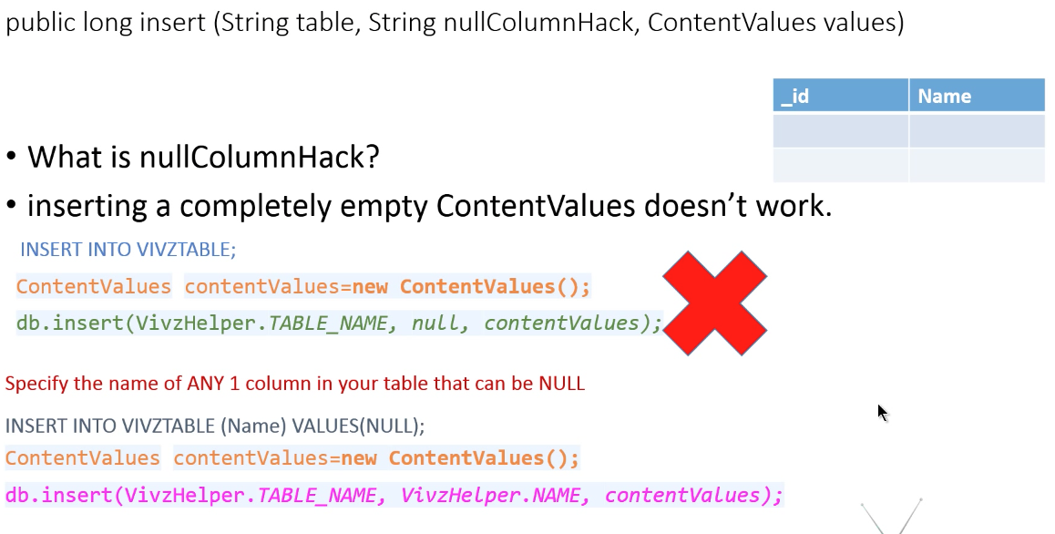
NULLHACK Column
May & June 2012 Recruiting Plan
q
© 2014 Unbounded Solutions
29

Slide 30
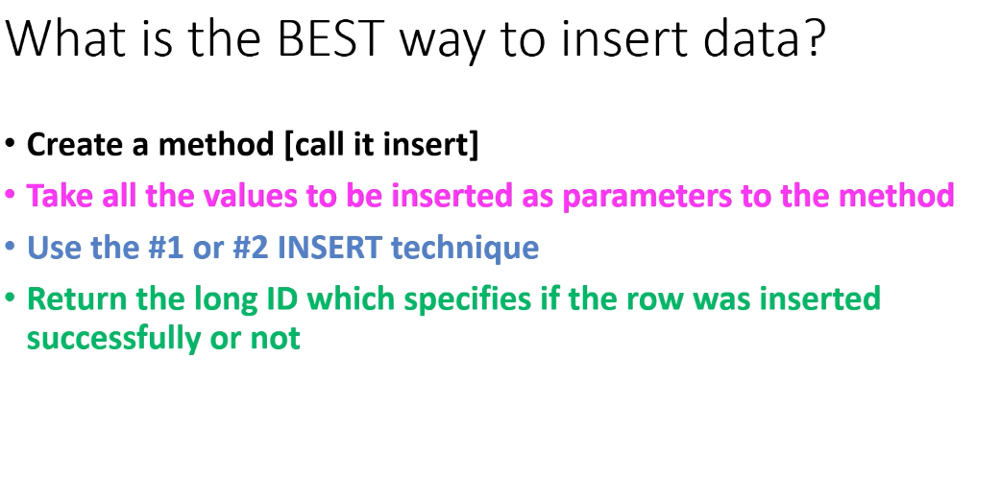
Steps
May & June 2012 Recruiting Plan
q
© 2014 Unbounded Solutions
30

Slide 31
Select Query

Slide 32
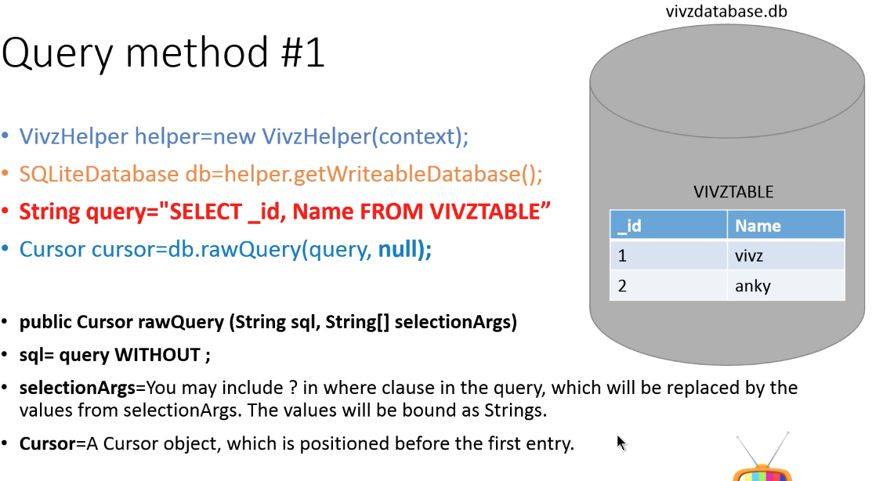
Searching in Database
May & June 2012 Recruiting Plan
q
© 2014 Unbounded Solutions
32

Slide 33
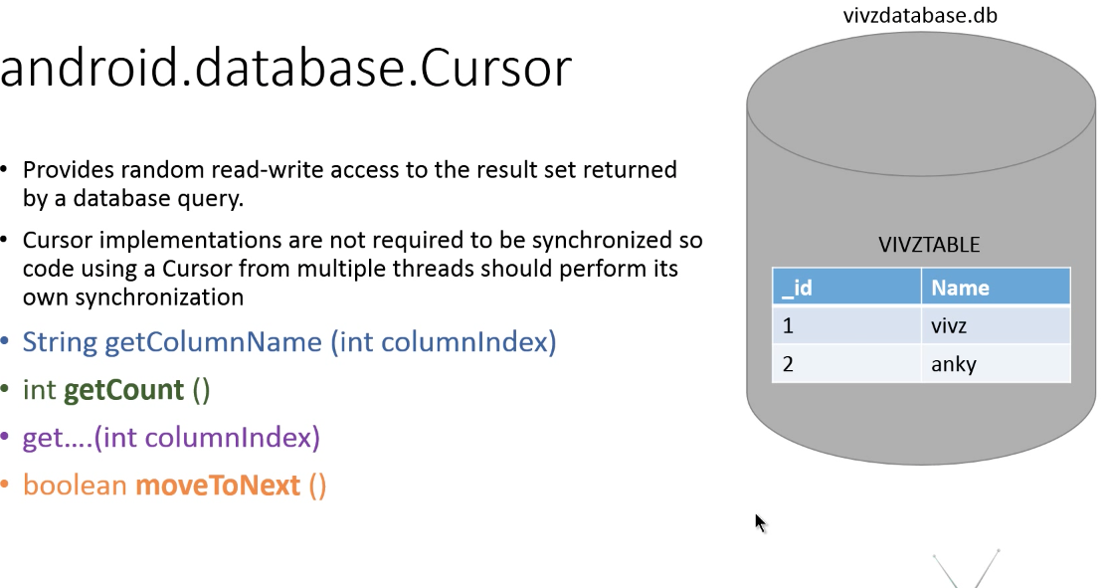
Cursor Object
May & June 2012 Recruiting Plan
q
© 2014 Unbounded Solutions
33

Slide 34
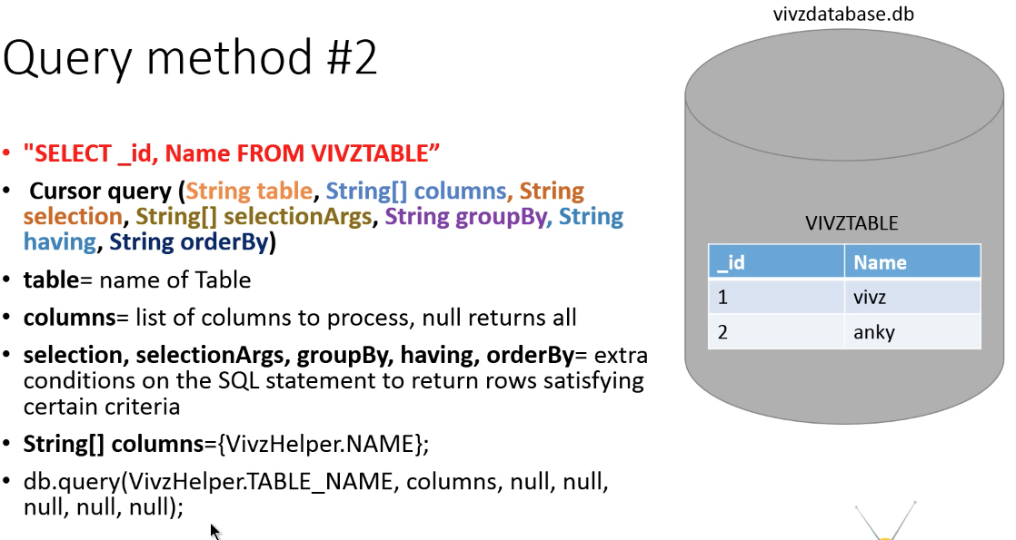
Searching the Database2
May & June 2012 Recruiting Plan
q
© 2014 Unbounded Solutions
34

Slide 35
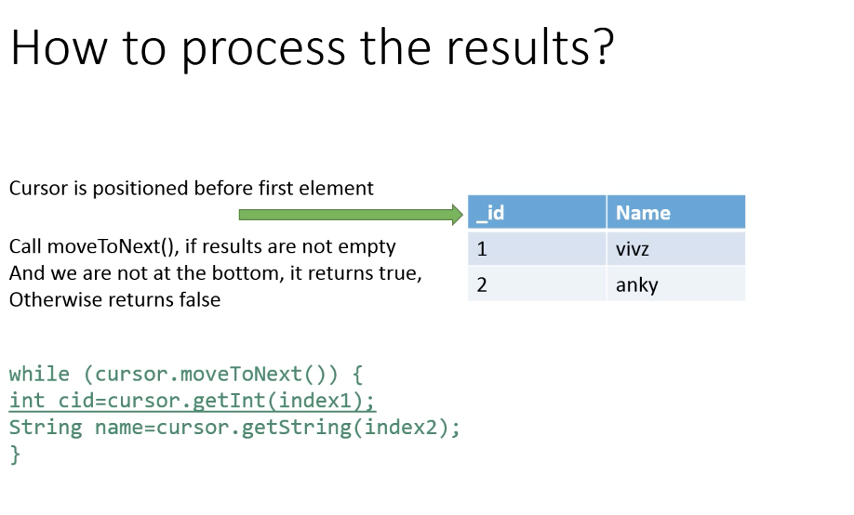
Cursor Process
May & June 2012 Recruiting Plan
q
© 2014 Unbounded Solutions
35

Slide 36
Delete Query

Slide 37
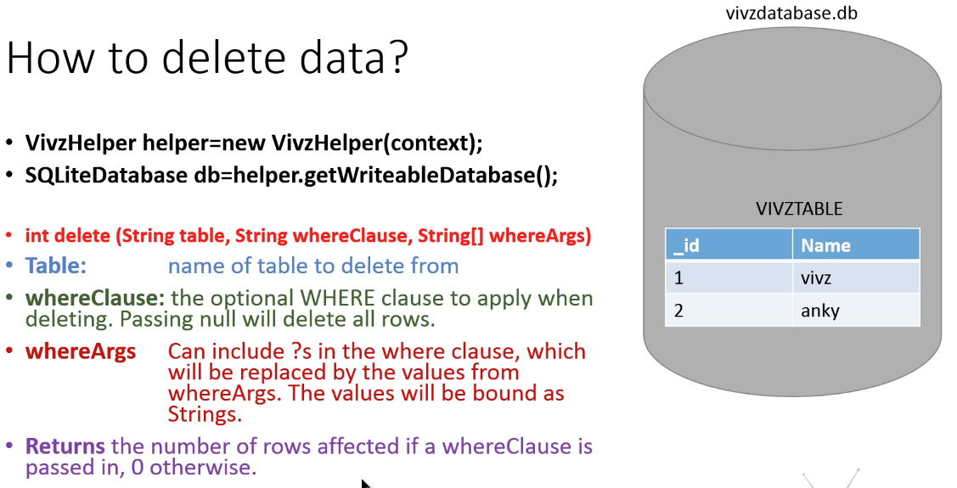
Delete Query
May & June 2012 Recruiting Plan
q
© 2014 Unbounded Solutions
37

Slide 38
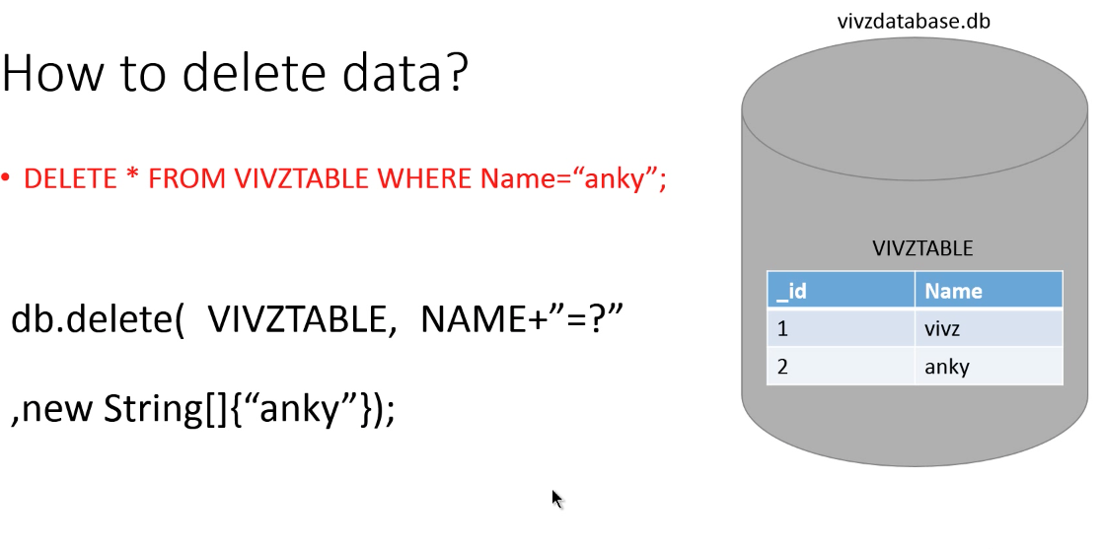
Delete Query
May & June 2012 Recruiting Plan
q
© 2014 Unbounded Solutions
38

Slide 39
Update Query

Slide 40
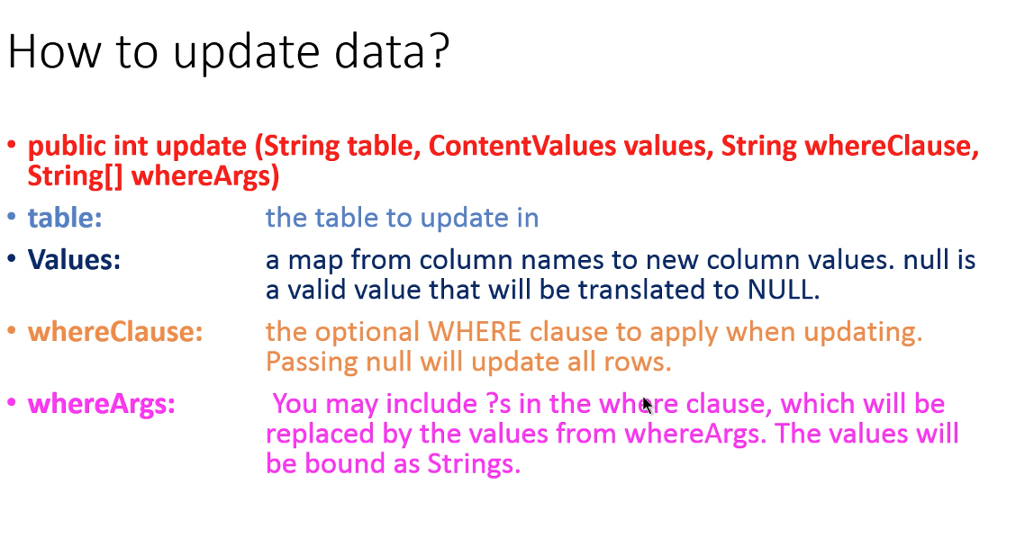
Update Query
May & June 2012 Recruiting Plan
q
© 2014 Unbounded Solutions
40

Slide 41
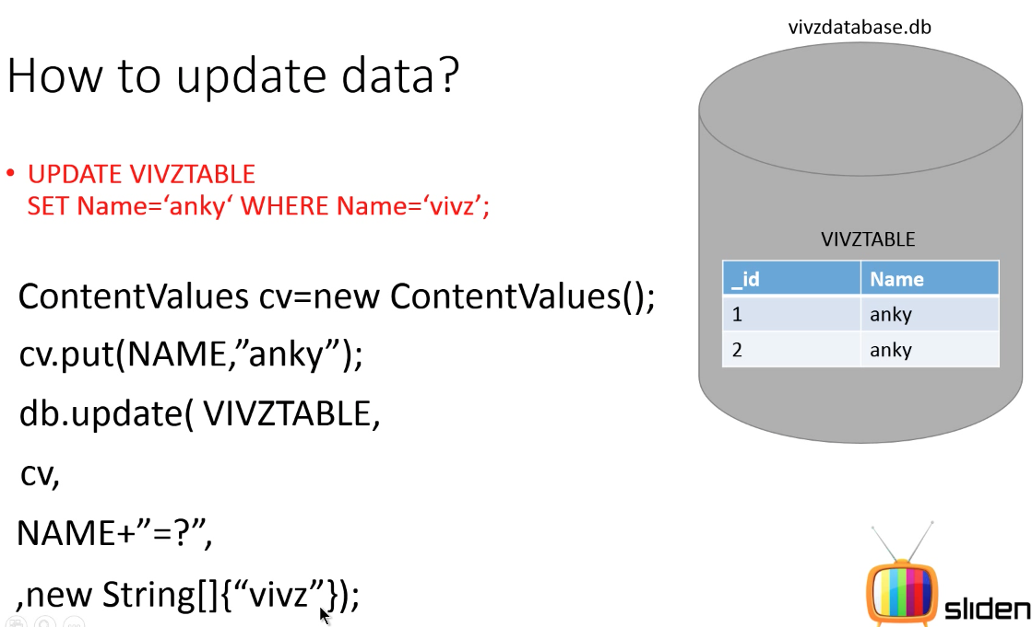
Update Query
May & June 2012 Recruiting Plan
q
© 2014 Unbounded Solutions
41

Slide 42
Tutorial #1
May & June 2012 Recruiting Plan
Recruit 70 “Best Fit” Consulting Employees
Build out a Marketing team dedicated to recruiting
Formalize training program for new recruiters
Build out fully functioning offshore recruiting team
Implement call quality feedback loops
Coach and Mentor recruiters
Improve daily efficiency for recruiting team
Populating Spinner data from SQLite Database
© 2014 Unbounded Solutions
42

Slide 43
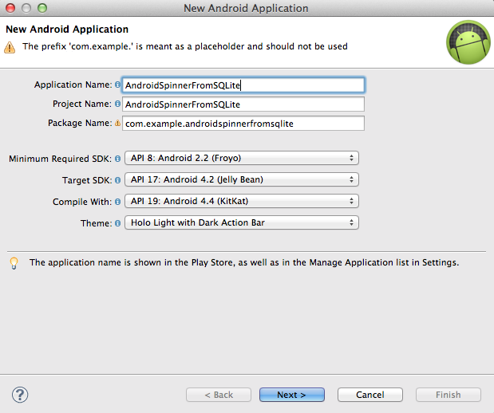
1#Create a New Application
May & June 2012 Recruiting Plan
q
© 2014 Unbounded Solutions
43

Slide 44
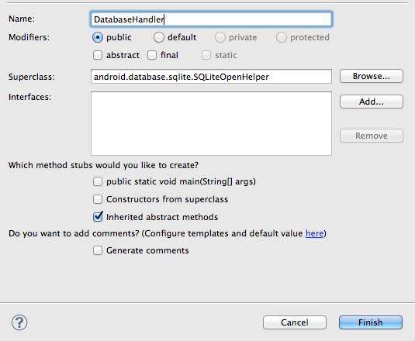
2#Creating SQLite Database Handler Class
May & June 2012 Recruiting Plan
q
© 2014 Unbounded Solutions
44

Slide 45
2.1#Declare the Constants
May & June 2012 Recruiting Plan
q
// Database Version
private static final int DATABASE_VERSION = 1;
// Database Name
private static final String DATABASE_NAME = "spinnerExample";
// Labels table name
private static final String TABLE_LABELS = "labels";
// Labels Table Columns names
private static final String KEY_ID = "id";
private static final String KEY_NAME = "name";
© 2014 Unbounded Solutions
45

Slide 46
2.2#Create Constructor
May & June 2012 Recruiting Plan
q
public DatabaseHandler(Context context) {
super(context,
DATABASE_NAME,
null,
DATABASE_VERSION);
}
© 2014 Unbounded Solutions
46

Slide 47
2.3#OnCreate()
May & June 2012 Recruiting Plan
q
// Creating Tables
@Override
public void onCreate(SQLiteDatabase db) {
// Category table create query
String CREATE_CATEGORIES_TABLE = "CREATE TABLE " + TABLE_LABELS + "(”+ KEY_ID + " INTEGER PRIMARY KEY," + KEY_NAME + " TEXT)";
db.execSQL(CREATE_CATEGORIES_TABLE);
}
© 2014 Unbounded Solutions
47

Slide 48
2.4#OnUpgrade()
May & June 2012 Recruiting Plan
q
// Upgrading database
@Override
public void onUpgrade(SQLiteDatabase db, int oldVersion, int newVersion) {
// Drop older table if existed
db.execSQL("DROP TABLE IF EXISTS " + TABLE_LABELS);
// Create tables again
onCreate(db);
}
© 2014 Unbounded Solutions
48

Slide 49
2.5#Create a New Class
May & June 2012 Recruiting Plan
q
/**
* Inserting new lable into lables table
* */
public void insertLabel(String label){
SQLiteDatabase db = this.getWritableDatabase();
ContentValues values = new ContentValues();
values.put(KEY_NAME, label);
// Inserting Row
db.insert(TABLE_LABELS, null, values);
db.close(); // Closing database connection
}
© 2014 Unbounded Solutions
49

Slide 50
2.6#Cursor Query
May & June 2012 Recruiting Plan
/**
* Getting all labels
* returns list of labels
* */
public List<String> getAllLabels(){
List<String> labels = new ArrayList<String>();
// Select All Query
String selectQuery = "SELECT * FROM " + TABLE_LABELS;
SQLiteDatabase db = this.getReadableDatabase();
Cursor cursor = db.rawQuery(selectQuery, null);
// looping through all rows and adding to list
if (cursor.moveToFirst()) {
do {
labels.add(cursor.getString(1));
} while (cursor.moveToNext());
}
q
© 2014 Unbounded Solutions
50

Slide 51
2.6#Cursor Query
May & June 2012 Recruiting Plan
q
// closing connection
cursor.close();
db.close();
// returning lables
return labels;
}
}
© 2014 Unbounded Solutions
51

Slide 52
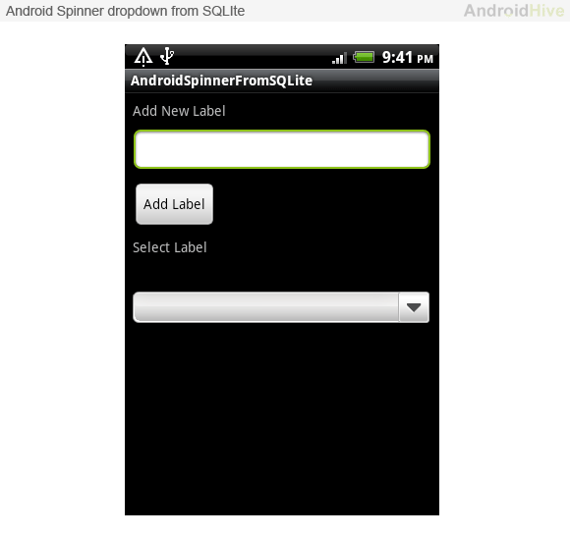
3#Design Layout
May & June 2012 Recruiting Plan
<LinearLayout xmlns:android="http://schemas.android.com/apk/res/android"
android:layout_width="fill_parent"
android:layout_height="fill_parent"
android:orientation="vertical" >
<!-- Label -->
<TextView
android:layout_width="fill_parent"
android:layout_height="wrap_content"
android:text="Add New Label"
android:padding="8dip" />
<!-- Input Text -->
<EditText android:id="@+id/input_label"
android:layout_width="fill_parent"
android:layout_height="wrap_content"
android:layout_marginLeft="8dip"
android:layout_marginRight="8dip"/>
q
© 2014 Unbounded Solutions
52

Slide 53
3#Design Layout
May & June 2012 Recruiting Plan
<!-- Add Button -->
<Button android:id="@+id/btn_add"
android:layout_width="wrap_content"
android:layout_height="wrap_content"
android:text="Add Label"
android:layout_marginLeft="8dip"
android:layout_marginTop="8dip"/>
<!-- Select Label -->
<TextView
android:layout_width="fill_parent"
android:layout_height="wrap_content"
android:text="Select Label"
android:padding="8dip" />
<!-- Spinner Dropdown -->
<Spinner
android:id="@+id/spinner"
android:layout_width="fill_parent"
android:layout_height="wrap_content"
android:prompt="@string/spinner_title"
android:layout_marginTop="20dip"
android:layout_marginLeft="8dip"
android:layout_marginRight="8dip"
/>
</LinearLayout>
q
© 2014 Unbounded Solutions
53

Slide 54
Concept
May & June 2012 Recruiting Plan
q
Now open your main activity class and try the following code(In my case AndroidSpinnerFromSQLiteActivity.java is my main activity). In the following code
⇒ loadSpinnerData() is called on onCreate() method to load the spinner data from SQLite database ⇒ Once Add button is clicked, new label is inserted into database ⇒ After new label inserted into database, again loadSpinnerData() is called to load the spinner with newly added data from SQLite database
© 2014 Unbounded Solutions
54

Slide 55
4#Update .Java File
May & June 2012 Recruiting Plan
@Override
public void onCreate(Bundle savedInstanceState) {
super.onCreate(savedInstanceState);
setContentView(R.layout.main);
// Spinner element
spinner = (Spinner) findViewById(R.id.spinner);
// add button
btnAdd = (Button) findViewById(R.id.btn_add);
// new label input field
inputLabel = (EditText) findViewById(R.id.input_label);
// Spinner click listener
spinner.setOnItemSelectedListener(this);
// Loading spinner data from database
loadSpinnerData();
q
© 2014 Unbounded Solutions
55

Slide 56
Call the Datahandler Class
May & June 2012 Recruiting Plan
btnAdd.setOnClickListener(new View.OnClickListener() {
@Override
public void onClick(View arg0) {
String label = inputLabel.getText().toString();
if (label.trim().length() > 0) {
// database handler
DatabaseHandler db = new DatabaseHandler(
getApplicationContext());
// inserting new label into database
db.insertLabel(label);
// making input filed text to blank
inputLabel.setText("");
q
© 2014 Unbounded Solutions
56

Slide 57
Call the Datahandler Class
May & June 2012 Recruiting Plan
// Hiding the keyboard
InputMethodManager imm = (InputMethodManager) getSystemService(Context.INPUT_METHOD_SERVICE);
imm.hideSoftInputFromWindow(inputLabel.getWindowToken(), 0);
// loading spinner with newly added data
loadSpinnerData();
} else {
Toast.makeText(getApplicationContext(), "Please enter label name",
Toast.LENGTH_SHORT).show();
}
}
});
}
q
© 2014 Unbounded Solutions
57

Slide 58
Spinner Function
May & June 2012 Recruiting Plan
/**
* Function to load the spinner data from SQLite database
* */
private void loadSpinnerData() {
// database handler
DatabaseHandler db = new DatabaseHandler(getApplicationContext());
// Spinner Drop down elements
List<String> lables = db.getAllLabels();
// Creating adapter for spinner
ArrayAdapter<String> dataAdapter = new ArrayAdapter<String>(this,
android.R.layout.simple_spinner_item, lables);
// Drop down layout style - list view with radio button
dataAdapter.setDropDownViewResource(android.R.layout.simple_spinner_dropdown_item);
// attaching data adapter to spinner
spinner.setAdapter(dataAdapter);
}
q
© 2014 Unbounded Solutions
58

Slide 59
Item Selected
May & June 2012 Recruiting Plan
@Override
public void onItemSelected(AdapterView<?> parent, View view, int position,
long id) {
// On selecting a spinner item
String label = parent.getItemAtPosition(position).toString();
// Showing selected spinner item
Toast.makeText(parent.getContext(), "You selected: " + label,
Toast.LENGTH_LONG).show();
}
@Override
public void onNothingSelected(AdapterView<?> arg0) {
// TODO Auto-generated method stub
}
q
© 2014 Unbounded Solutions
59

Slide 60
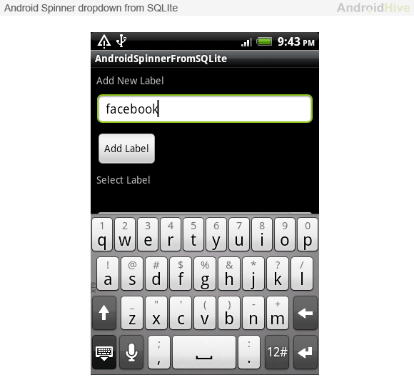
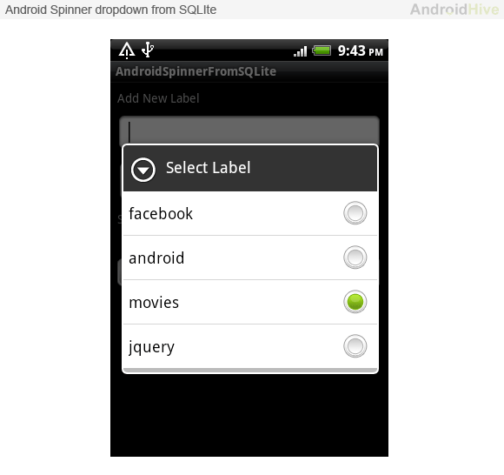
Output
May & June 2012 Recruiting Plan
q
© 2014 Unbounded Solutions
60

Slide 61
Topic #3
May & June 2012 Recruiting Plan
Recruit 70 “Best Fit” Consulting Employees
Build out a Marketing team dedicated to recruiting
Formalize training program for new recruiters
Build out fully functioning offshore recruiting team
Implement call quality feedback loops
Coach and Mentor recruiters
Improve daily efficiency for recruiting team
SQLite Database with Multiple Tables
© 2014 Unbounded Solutions
61

Slide 62
// Table Create Statements
// Todo table create statement
private static final String CREATE_TABLE_TODO = "CREATE TABLE "
+ TABLE_TODO + "(" + KEY_ID + " INTEGER PRIMARY KEY," + KEY_TODO
+ " TEXT," + KEY_STATUS + " INTEGER," + KEY_CREATED_AT
+ " DATETIME" + ")";
// Tag table create statement
private static final String CREATE_TABLE_TAG = "CREATE TABLE " + TABLE_TAG
+ "(" + KEY_ID + " INTEGER PRIMARY KEY," + KEY_TAG_NAME + " TEXT,"
+ KEY_CREATED_AT + " DATETIME" + ")";
// todo_tag table create statement
private static final String CREATE_TABLE_TODO_TAG = "CREATE TABLE "
+ TABLE_TODO_TAG + "(" + KEY_ID + " INTEGER PRIMARY KEY,"
+ KEY_TODO_ID + " INTEGER," + KEY_TAG_ID + " INTEGER,"
+ KEY_CREATED_AT + " DATETIME" + ")";
May & June 2012 Recruiting Plan
Recruit 70 “Best Fit” Consulting Employees
Build out a Marketing team dedicated to recruiting
Formalize training program for new recruiters
Build out fully functioning offshore recruiting team
Implement call quality feedback loops
Coach and Mentor recruiters
Improve daily efficiency for recruiting team
© 2014 Unbounded Solutions
62

Slide 63
@Override
public void onCreate(SQLiteDatabase db) {
// creating required tables
db.execSQL(CREATE_TABLE_TODO);
db.execSQL(CREATE_TABLE_TAG);
db.execSQL(CREATE_TABLE_TODO_TAG);
}
@Override
public void onUpgrade(SQLiteDatabase db, int oldVersion, int newVersion) {
// on upgrade drop older tables
db.execSQL("DROP TABLE IF EXISTS " + TABLE_TODO);
db.execSQL("DROP TABLE IF EXISTS " + TABLE_TAG);
db.execSQL("DROP TABLE IF EXISTS " + TABLE_TODO_TAG);
// create new tables
onCreate(db);
}
May & June 2012 Recruiting Plan
Recruit 70 “Best Fit” Consulting Employees
Build out a Marketing team dedicated to recruiting
Formalize training program for new recruiters
Build out fully functioning offshore recruiting team
Implement call quality feedback loops
Coach and Mentor recruiters
Improve daily efficiency for recruiting team
© 2014 Unbounded Solutions
63

Slide 64
Sychronization

Slide 65
Topic #4
May & June 2012 Recruiting Plan
Recruit 70 “Best Fit” Consulting Employees
Build out a Marketing team dedicated to recruiting
Formalize training program for new recruiters
Build out fully functioning offshore recruiting team
Implement call quality feedback loops
Coach and Mentor recruiters
Improve daily efficiency for recruiting team
How to sync Remote MySQL DB to SQLite on Android
© 2014 Unbounded Solutions
65

Slide 66
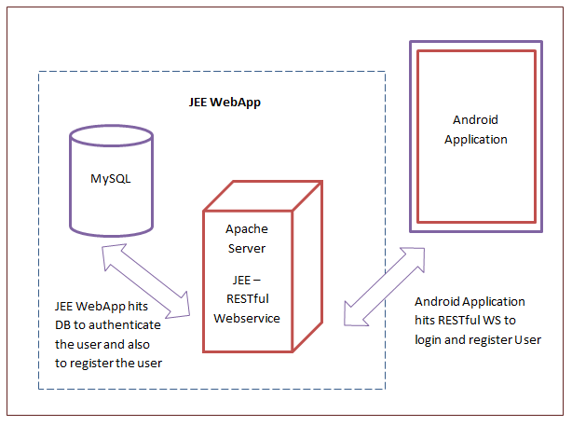
May & June 2012 Recruiting Plan
© 2014 Unbounded Solutions
66

Slide 67
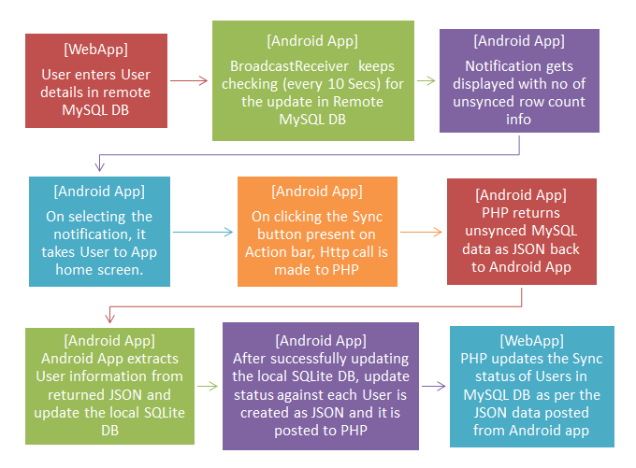
May & June 2012 Recruiting Plan
© 2014 Unbounded Solutions
67

Slide 68
Topic #5
May & June 2012 Recruiting Plan
Recruit 70 “Best Fit” Consulting Employees
Build out a Marketing team dedicated to recruiting
Formalize training program for new recruiters
Build out fully functioning offshore recruiting team
Implement call quality feedback loops
Coach and Mentor recruiters
Improve daily efficiency for recruiting team
How to sync SQLite on Android to MySQL DB?
© 2014 Unbounded Solutions
68

Slide 69
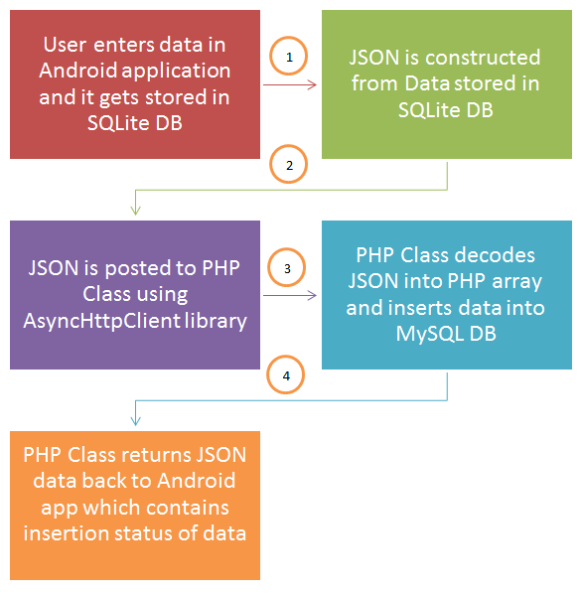
May & June 2012 Recruiting Plan
© 2014 Unbounded Solutions
69

Slide 70
EXERCISE

Slide 71

Exercise
May & June 2012 Recruiting Plan
Create a application which implements the data manipulation commands used in sqlite
Create an application having multiple tables in the application.
Design an application which uses atleast one of the system-defined content providers
Recruit 70 “Best Fit” Consulting Employees
Build out a Marketing team dedicated to recruiting
Formalize training program for new recruiters
Build out fully functioning offshore recruiting team
Implement call quality feedback loops
Coach and Mentor recruiters
Improve daily efficiency for recruiting team
© 2014 Unbounded Solutions
71

Slide 72
Shared Preferences

Slide 73
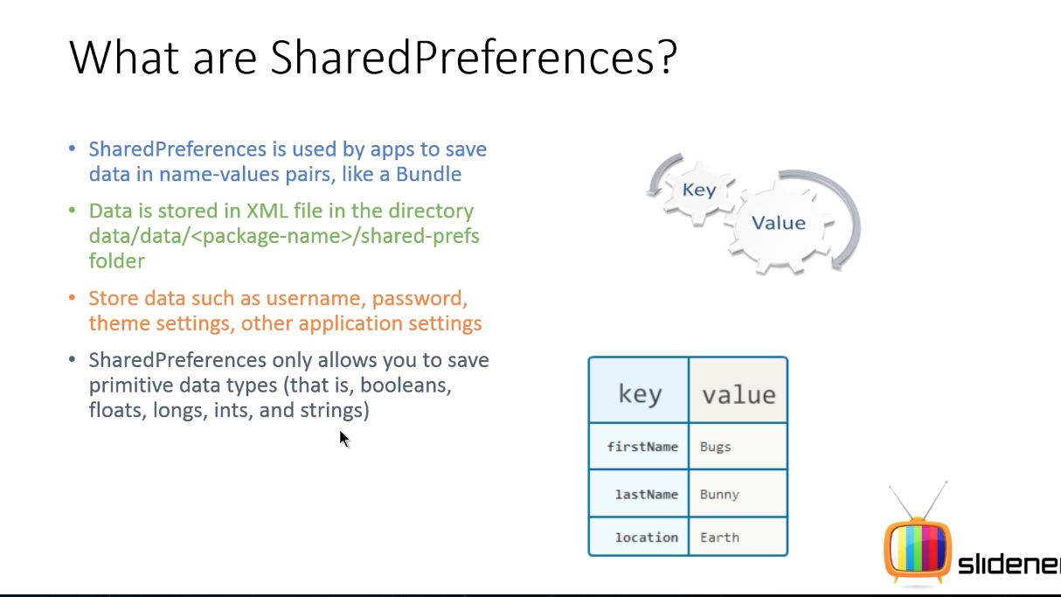
May & June 2012 Recruiting Plan
© 2014 Unbounded Solutions
73

Slide 74
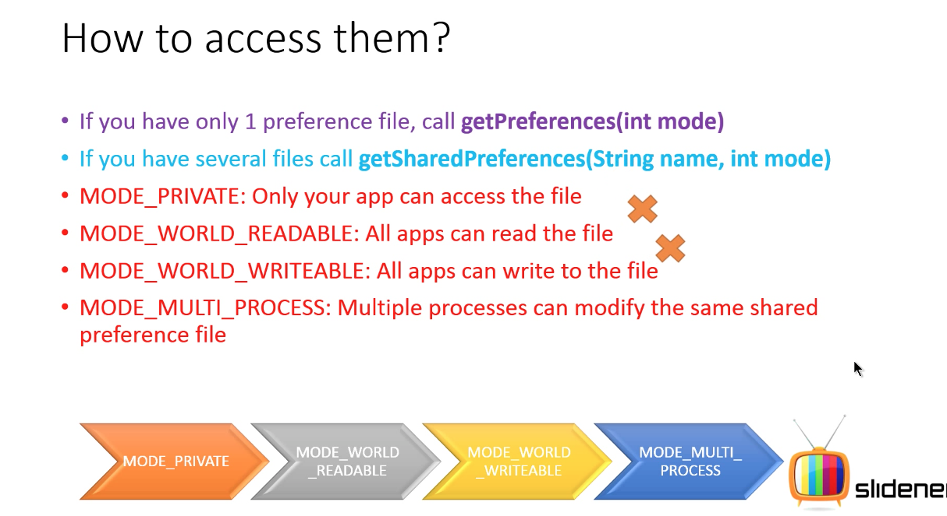
May & June 2012 Recruiting Plan
© 2014 Unbounded Solutions
74

Slide 75
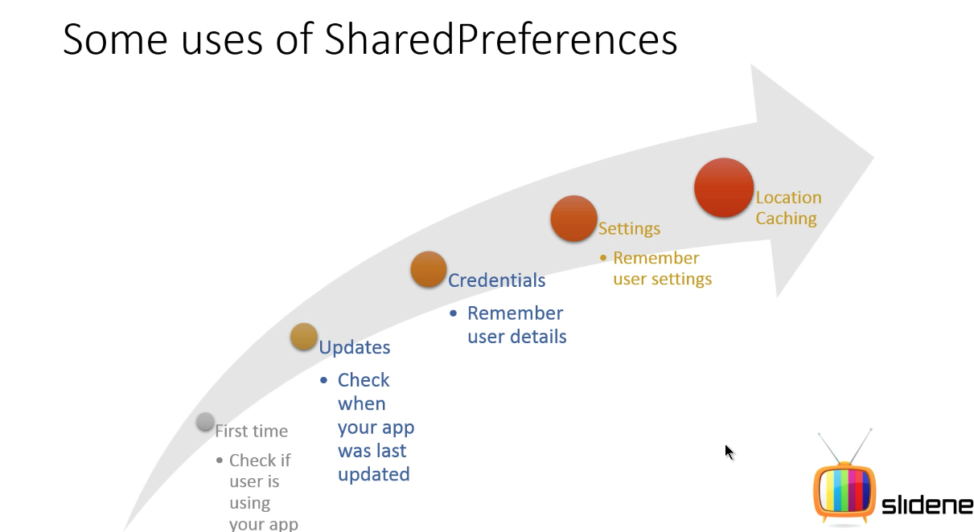
May & June 2012 Recruiting Plan
© 2014 Unbounded Solutions
75

Slide 76
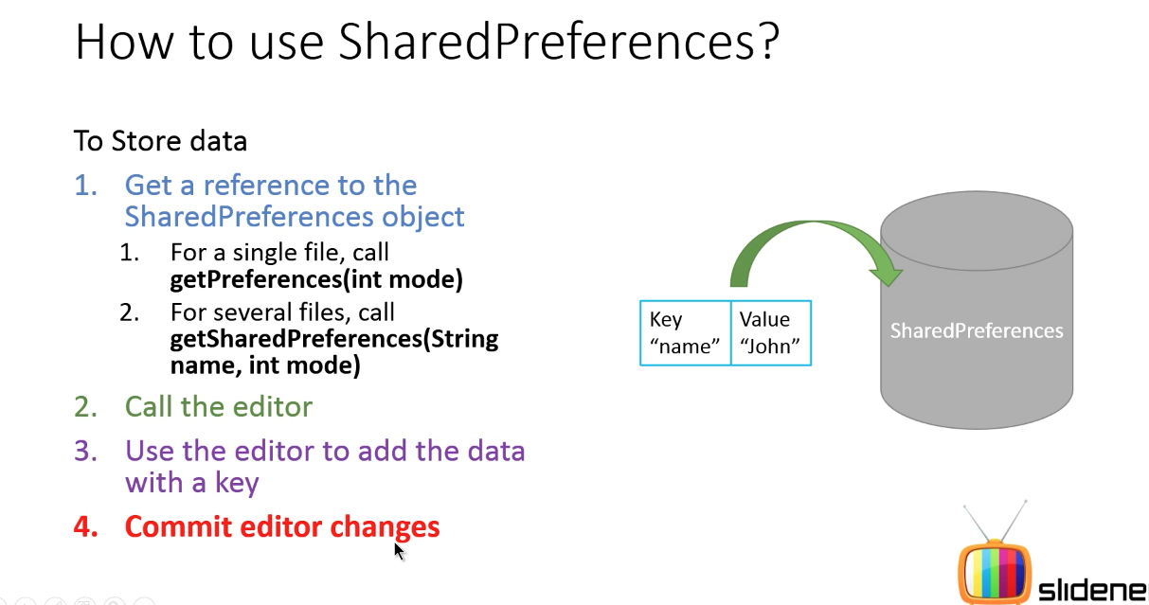
May & June 2012 Recruiting Plan
© 2014 Unbounded Solutions
76

Slide 77
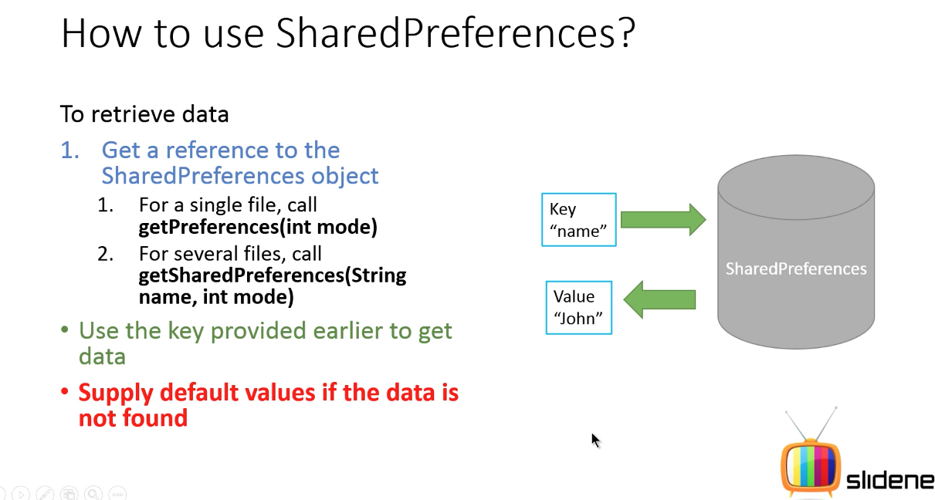
May & June 2012 Recruiting Plan
© 2014 Unbounded Solutions
77

Slide 78
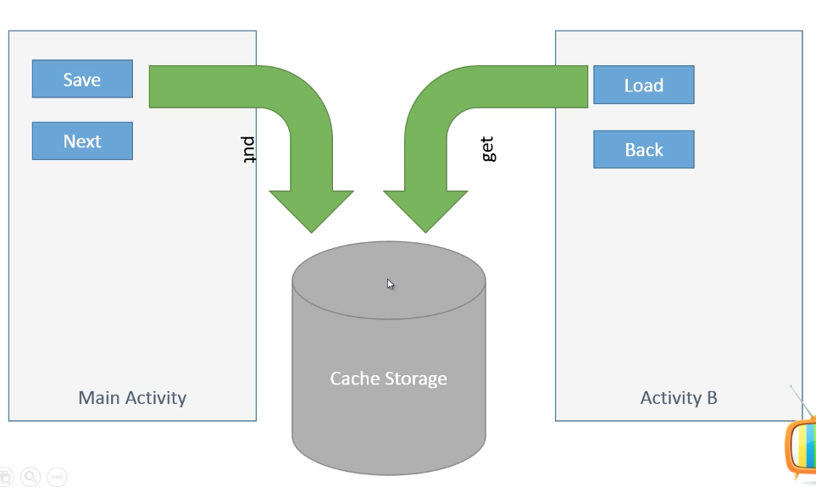
Example
May & June 2012 Recruiting Plan
Recruit 70 “Best Fit” Consulting Employees
Build out a Marketing team dedicated to recruiting
Formalize training program for new recruiters
Build out fully functioning offshore recruiting team
Implement call quality feedback loops
Coach and Mentor recruiters
Improve daily efficiency for recruiting team
© 2014 Unbounded Solutions
78

Slide 79
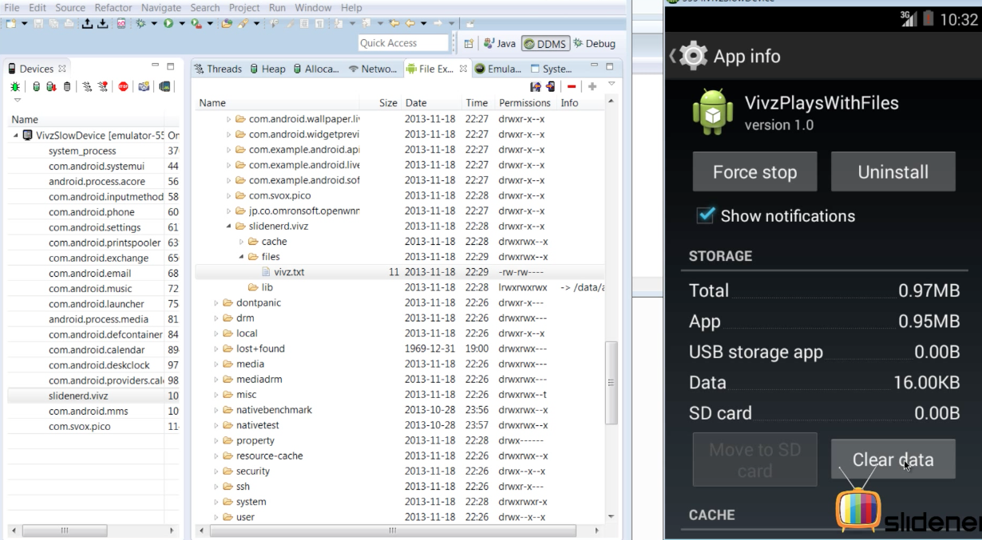
Erase Completely
May & June 2012 Recruiting Plan
Recruit 70 “Best Fit” Consulting Employees
Build out a Marketing team dedicated to recruiting
Formalize training program for new recruiters
Build out fully functioning offshore recruiting team
Implement call quality feedback loops
Coach and Mentor recruiters
Improve daily efficiency for recruiting team
© 2014 Unbounded Solutions
79

Slide 80
Tutorial#1
May & June 2012 Recruiting Plan
Recruit 70 “Best Fit” Consulting Employees
Build out a Marketing team dedicated to recruiting
Formalize training program for new recruiters
Build out fully functioning offshore recruiting team
Implement call quality feedback loops
Coach and Mentor recruiters
Improve daily efficiency for recruiting team
Get and Set Values
© 2014 Unbounded Solutions
80

Slide 81
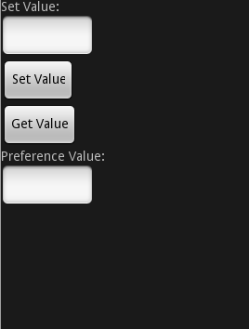
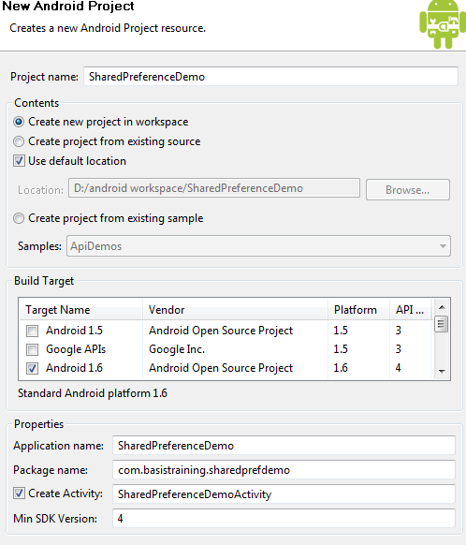
Shared Preferences for Persistence
May & June 2012 Recruiting Plan
We see an example of this:
We create a project:
We also create a layout
© 2014 Unbounded Solutions
81

Slide 82
Step#1 : Declare the Main Classes
May & June 2012 Recruiting Plan
public class SharedActivity extends Activity {
EditText etset,etget;
Button btnset,btnget,btnremove;
SharedPreferences app_pref;
SharedPreferences.Editor editor;
/** Called when the activity is first created. */
@Override
public void onCreate(Bundle savedInstanceState) {
© 2014 Unbounded Solutions
82

Slide 83
Step#2 : Initialize the Classes
May & June 2012 Recruiting Plan
@Override
public void onCreate(Bundle savedInstanceState) {
super.onCreate(savedInstanceState);
setContentView(R.layout.main);
//Step 1 declare
app_pref=PreferenceManager.getDefaultSharedPreferences(this);
//Step 2 declare
editor=app_pref.edit();
© 2014 Unbounded Solutions
83

Slide 84
Step#3 : Store the Values
May & June 2012 Recruiting Plan
btnset.setOnClickListener(new View.OnClickListener() {
@Override
public void onClick(View v) {
// TODO Auto-generated method stub
//Step 2 declare
editor=app_pref.edit();
editor.putString("myValue”, etset.getText().toString().trim());
editor.commit();
// Intent myIntent = new Intent(SharedActivity.this,Second.class);
// startActivity(myIntent);
}
});
© 2014 Unbounded Solutions
84

Slide 85
Step#4 : Retrieve the Values
May & June 2012 Recruiting Plan
btnget.setOnClickListener(new View.OnClickListener() {
@Override
public void onClick(View v) {
// TODO Auto-generated method stub
String myPref=app_pref.getString("myValue", "Nullll");
etget.setText(myPref);
}
});
© 2014 Unbounded Solutions
85

Slide 86
Step#5 : Clear the Values
May & June 2012 Recruiting Plan
btnremove.setOnClickListener(new View.OnClickListener() {
@Override
public void onClick(View v) {
// TODO Auto-generated method stub
editor.remove("myValue");
editor.commit(); // commit changes
}
});
}
© 2014 Unbounded Solutions
86

Slide 87
Step#7 : Share across Screens
May & June 2012 Recruiting Plan
SharedPreferences app_preferences = PreferenceManager.getDefaultSharedPreferences(this);
String text = app_preferences.getString("myValue", "null");
textView.setText(text);
© 2014 Unbounded Solutions
87

